Slide 1
UNIFIED MENTOR PROJECTS

Slide 2
About Me
Business Analyst Intern at Unified Mentor
Skilled in SQL, Power BI, Excel, Python & Financial Analytics
Focus: Turning data into strategic insights

Slide 3
Financial Performance Analysis
Prepared by: Rohit Karmakar
Business Analyst Intern, Unified Mentor

Slide 4
Project Overview
Multi-country, multi-product dataset
Includes Sales, Profit, COGS, Units Sold, Discounts
Analysis done using Excel + MySQL + Power BI
Goal: Evaluate business performance & profitability drivers

Slide 5
Problem Statement
The goal is to analyze financial performance using key KPIs:
Sales, Profit, COGS, Discounts across countries, segments, products, and time.

Slide 6
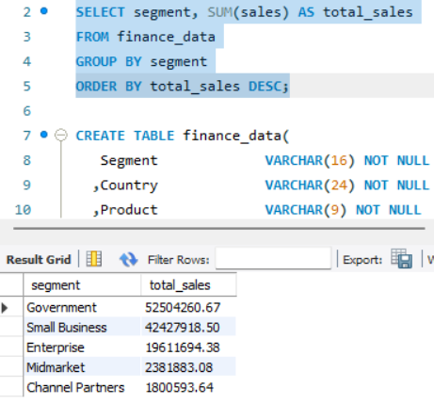
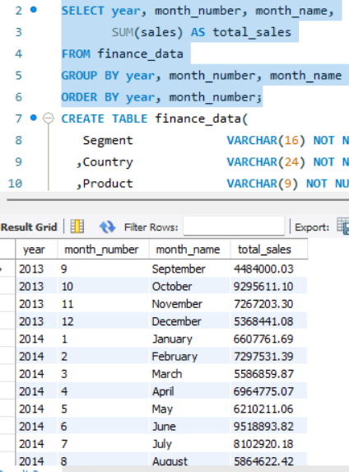
Sales Distribution by Segment
Purpose: See which segments contribute most revenue.
Sales Trends over Time
Purpose: Detect trends, growth or decline.
Source : MYSQL

Slide 7
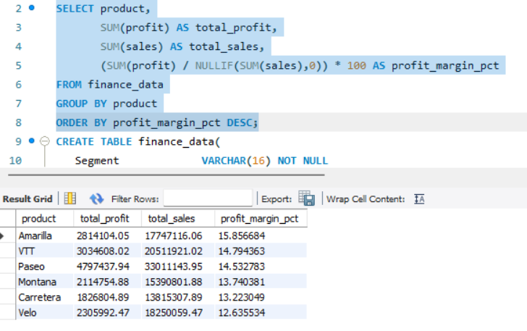
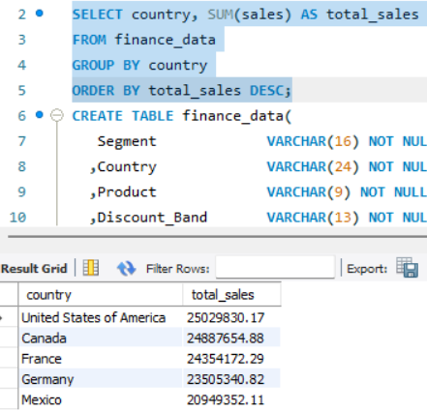
Profit Margins by Product
Purpose: Identify high-margin products.
Country-wise Sales Distribution
Purpose: Geographic conalescentration of revenue.
Source : MYSQL

Slide 8
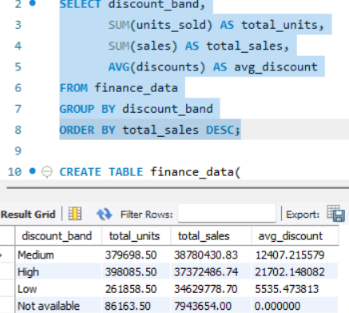
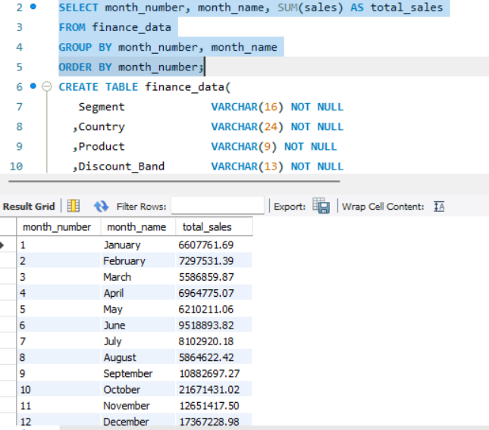
Discount Band Effects on Sales
Purpose: See how discount levels drive revenue.
Sales Distribution by Month
Purpose: Identify seasonality.
Source : MYSQL

Slide 9
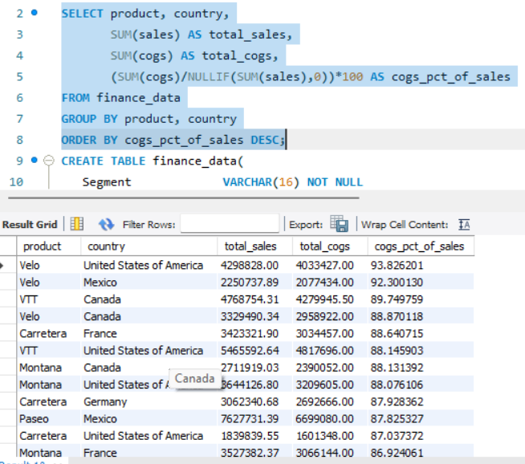
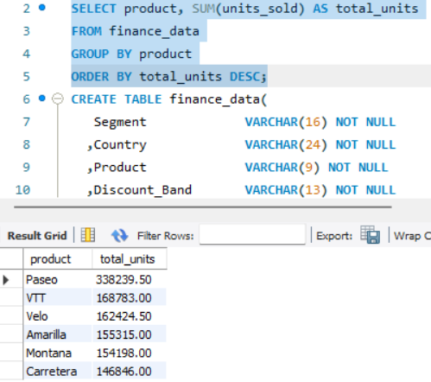
Top Products by Units Sold
Purpose: Product popularity.
COGS vs Sales
Purpose: Identify cost-heavy products/regions.
Source : MYSQL

Slide 10
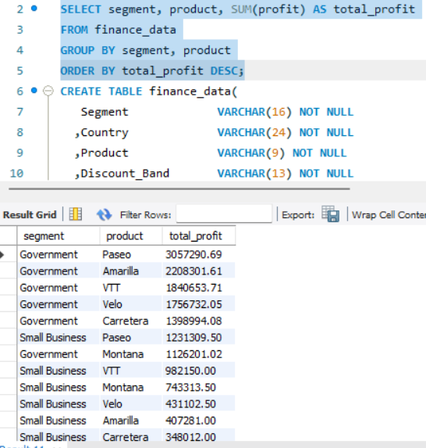
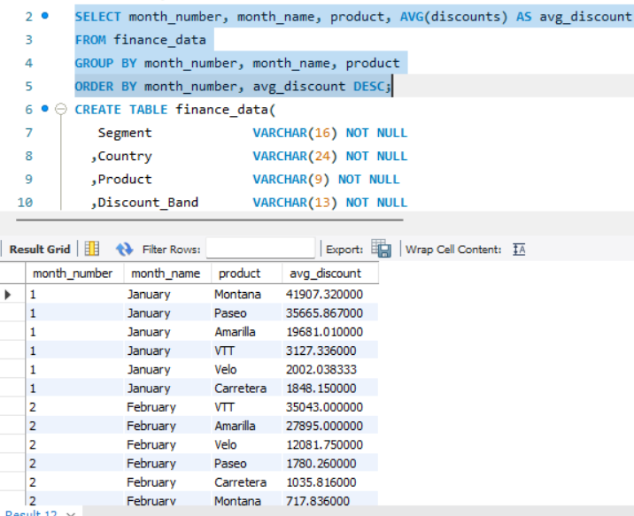
Profit by Segment and Product
Purpose: Cross-analyze profitability.
Discount Patterns
Purpose: Identify when/where discounts are applied.
Source : MYSQL

Slide 11
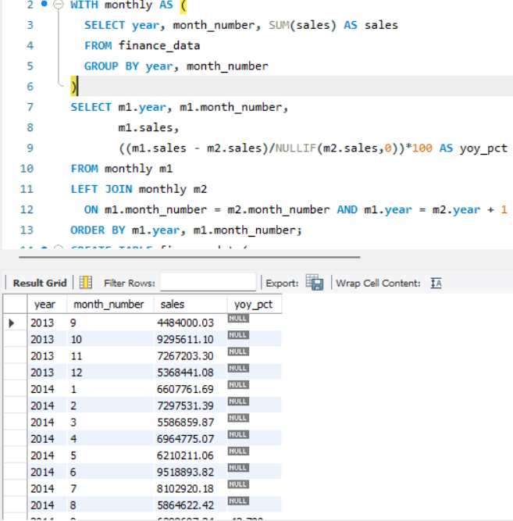
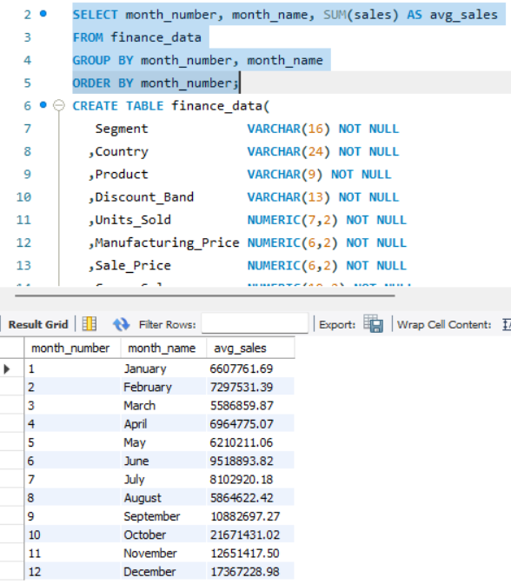
YoY Sales Growth
Purpose: Business growth evaluation.
Seasonal Sales Trends
Purpose: Identify recurring patterns.
Source : MYSQL

Slide 12
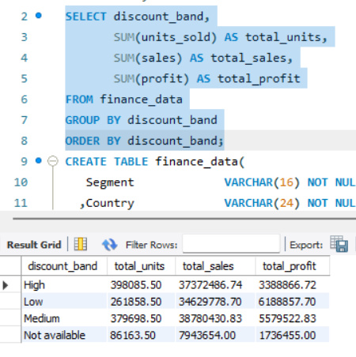
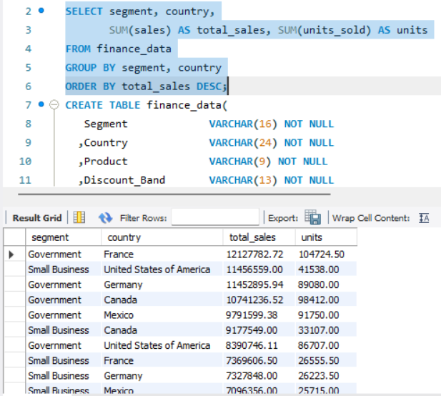
Discount Band Analysis
Purpose: Compare revenue lift vs discount levels.
Customer Segmentation Analysis
Purpose: Targeted strategies.
Source : MYSQL

Slide 13
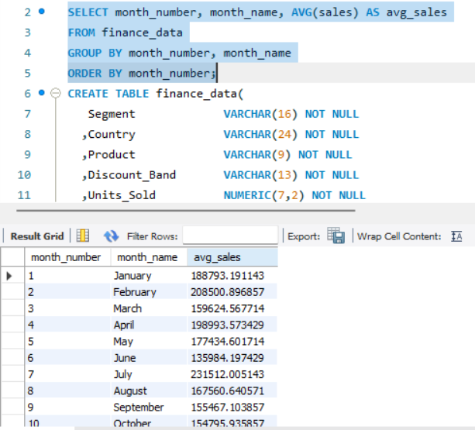
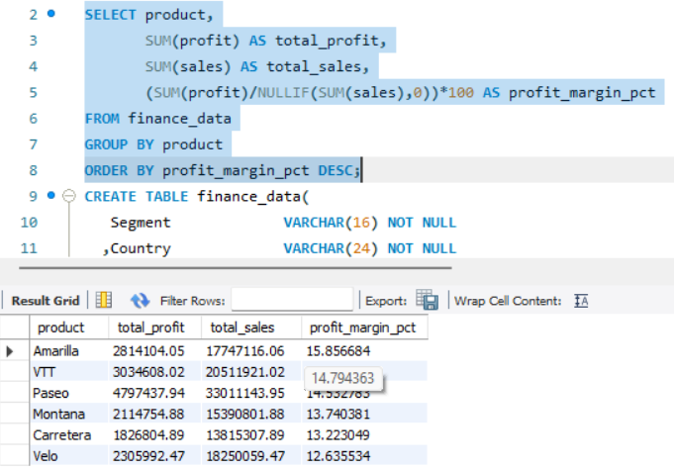
Monthly Average Sales
Purpose: Baseline for forecasting.
Profit Margin Distribution
Purpose: Risk vs reward across products.
Source : MYSQL

Slide 14
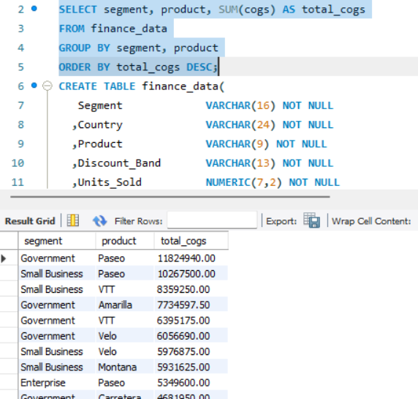
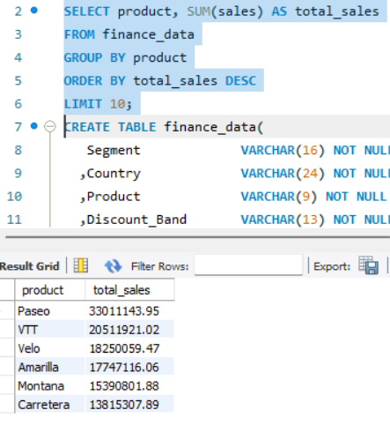
COGS Distribution
Purpose: Find cost-heavy clusters.
Top 10 SKU Revenue Pareto
Purpose: 80/20 inventory analysis.
Source : MYSQL

Slide 15
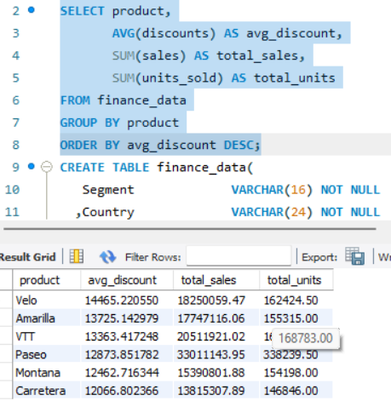
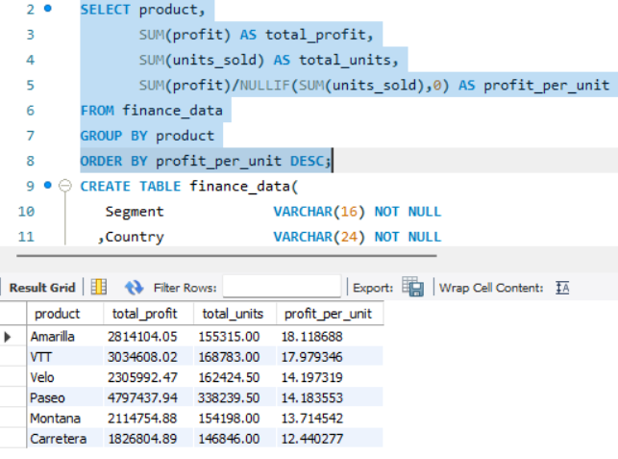
Avg Discount vs Sales Lift
Purpose: Find effective discounts.
Profit per Unit
Purpose: Understand unit economics.
Source : MYSQL

Slide 16
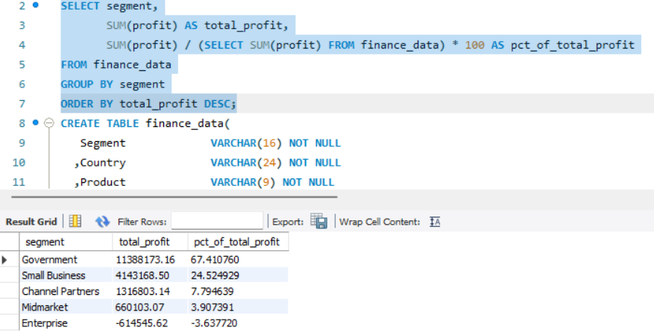
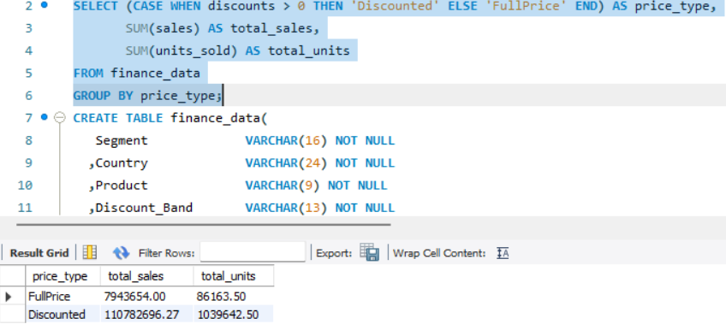
Margin Contribution by Segment
Purpose: Prioritize segments.
Discounted vs Non-discounted Sales
Purpose: Compare strategies.
Source : MYSQL

Slide 17
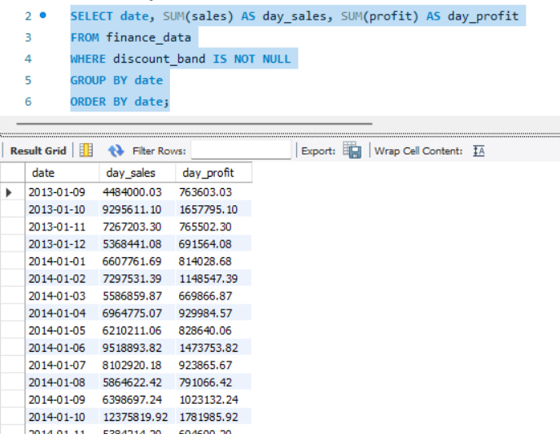
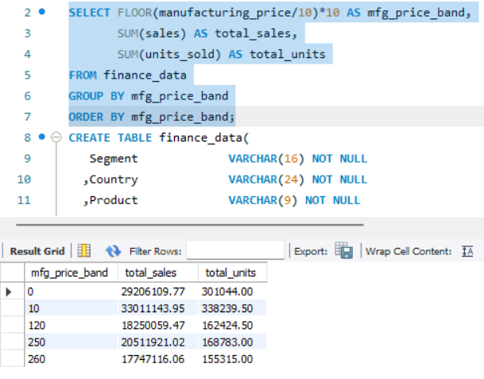
Time-to-profit Recovery
Purpose: Margin loss recovery time.
Sales per Manufacturing Price Band
Purpose: Pricing/markup strategy.
Source : MYSQL

Slide 18
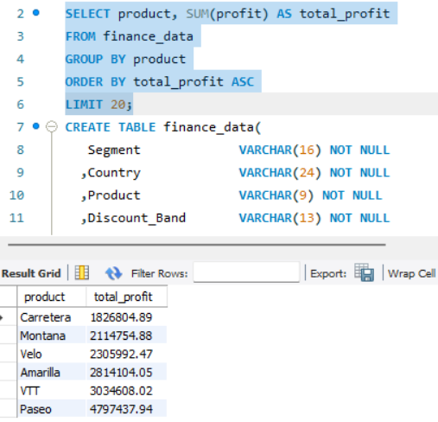
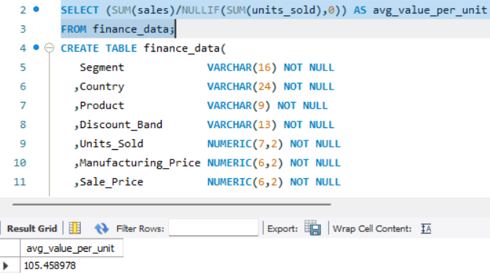
Worst Products by Profit
Purpose: Identify loss-makers.
Average Order Value (AOV)
Purpose: Customer spend per order.
Source : MYSQL

Slide 19
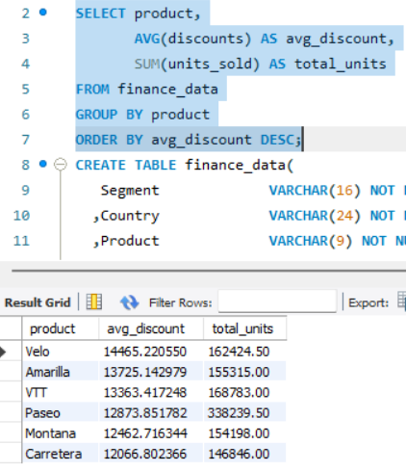
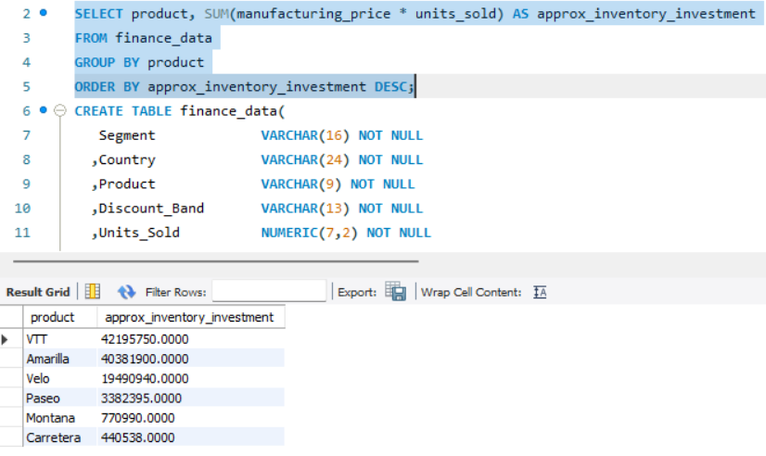
Price Elasticity Proxy
Purpose: Unit responsiveness to discounts.
Inventory Investment Proxy
Purpose: Working capital impact.
Source : MYSQL

Slide 20
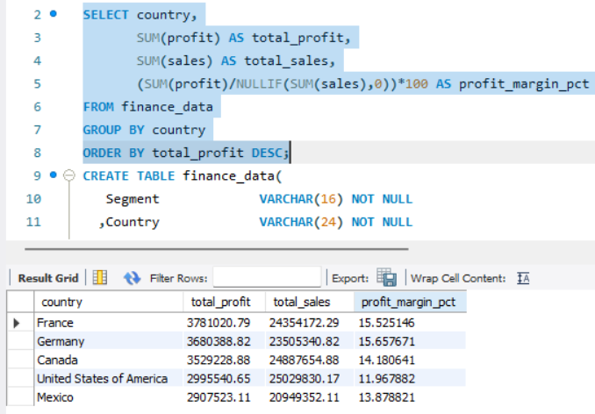
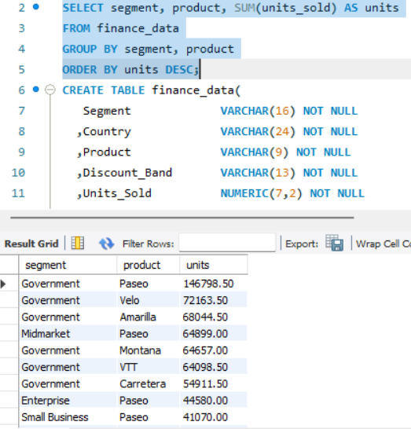
Country-level Profitability
Purpose: Market prioritization.
Cross-sell Potential
Purpose: Segment × product affinity.
Source : MYSQL

Slide 21
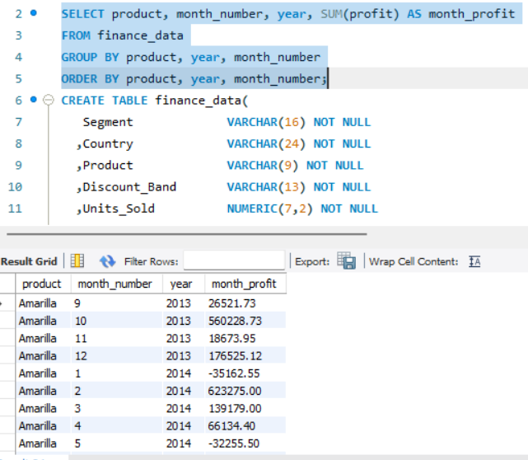
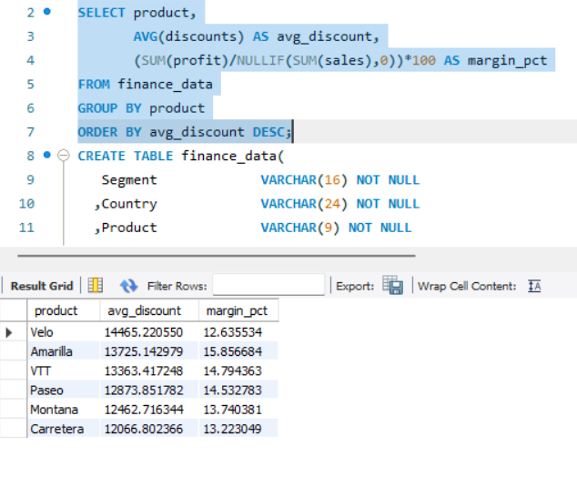
Profit Volatility
Purpose: Identify unstable products.
Discount Depth vs Margin Impact
Purpose: Find margin destruction.
Source : MYSQL

Slide 22
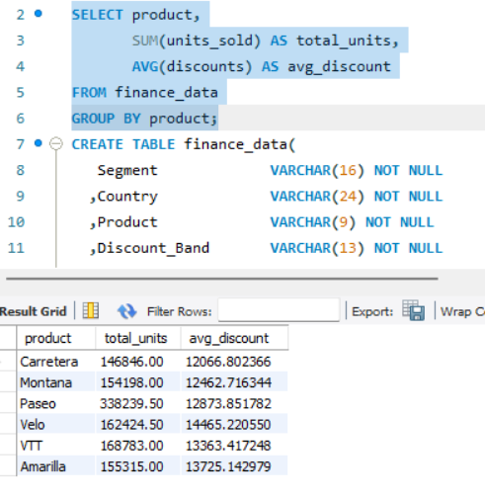
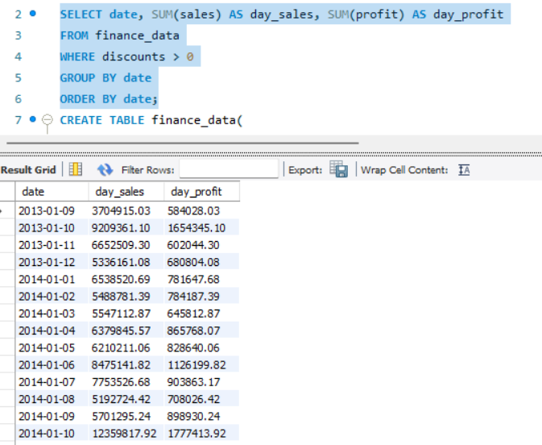
Profit Recovery Ratio
Purpose: Units uplift per 1% discount.
Lead Time to Profitability
Purpose: Campaign evaluation.
Source : MYSQL

Slide 23
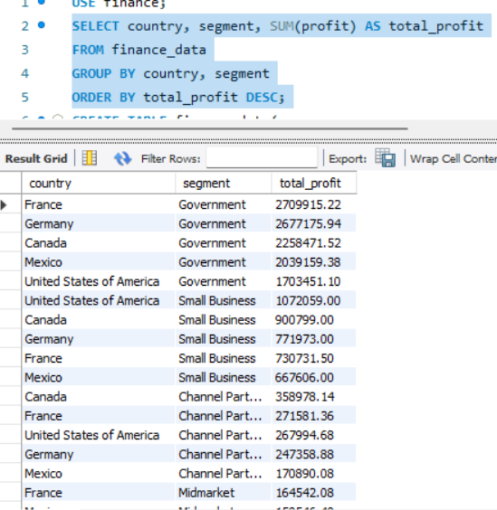
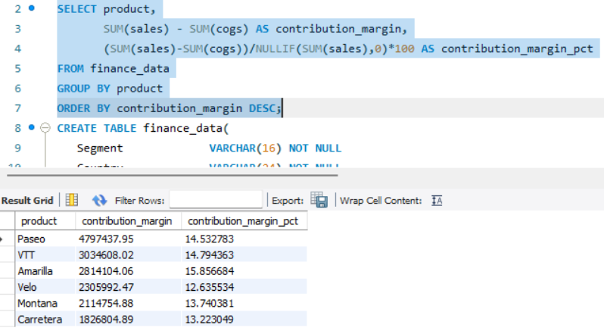
Contribution Margin
Purpose: Helper for fixed cost coverage.
Profit per Country-Segment
Purpose: Detailed P&L slicing.
Source : MYSQL

Slide 24
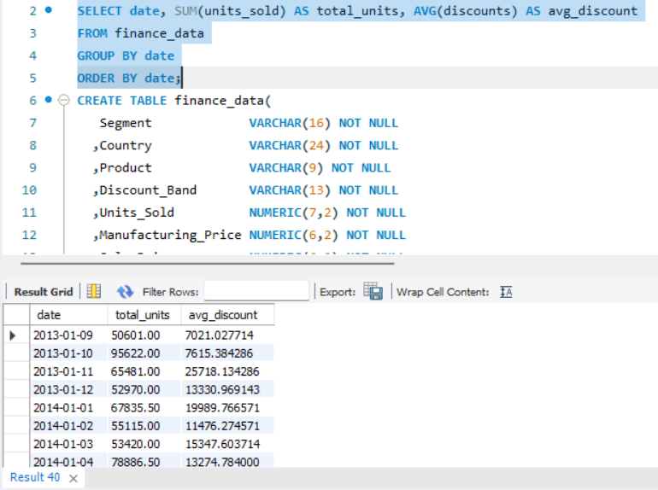
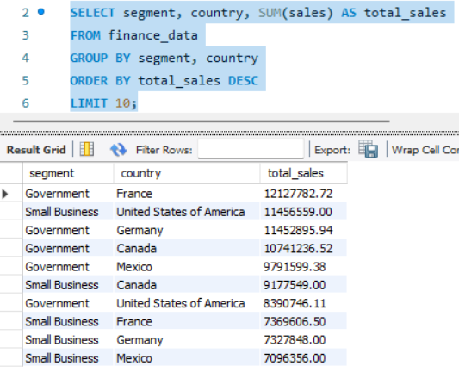
Units Sold vs Discounts Trend
Purpose: Does discount drive units?
Top 10 Customers
Purpose: Major revenue pockets.
Source : MYSQL

Slide 25
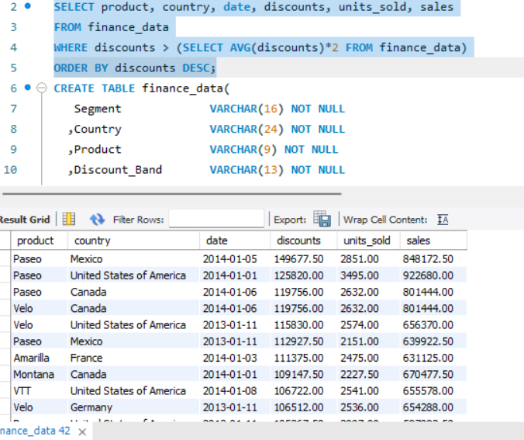
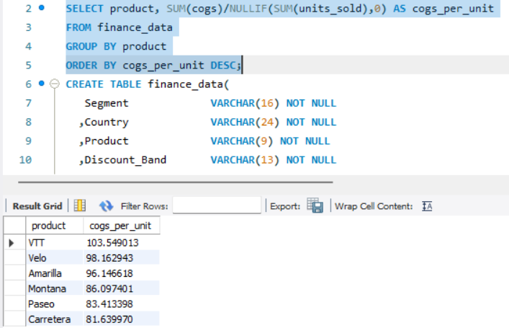
Discount Abuse Detection
Purpose: Detect misused discounts.
COGS per Unit by Product
Purpose: Determine price floors.
Source : MYSQL

Slide 26
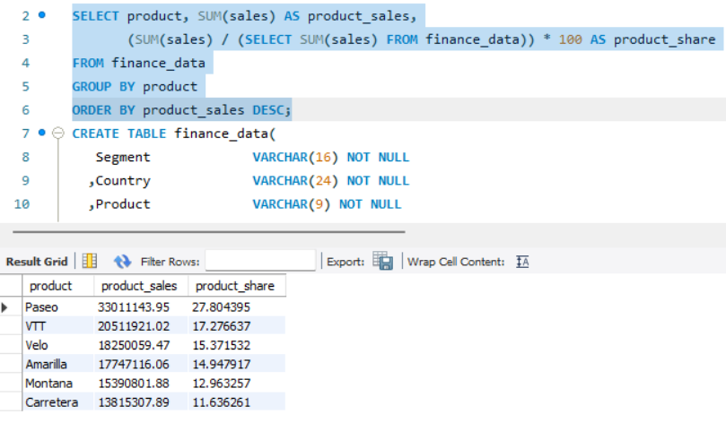
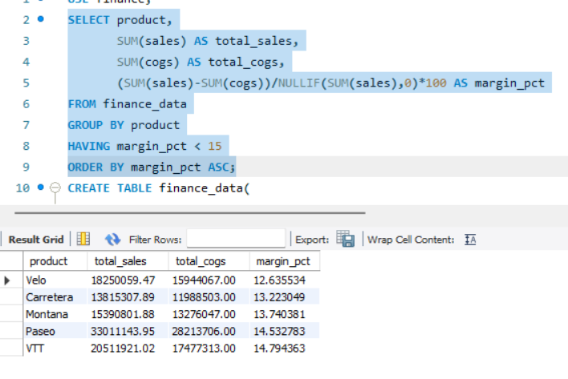
Sales Growth vs Market Growth
Purpose: Relative performance.
Products Needing Price Increase
Purpose: Low margin + high costs.
Source : MYSQL

Slide 27
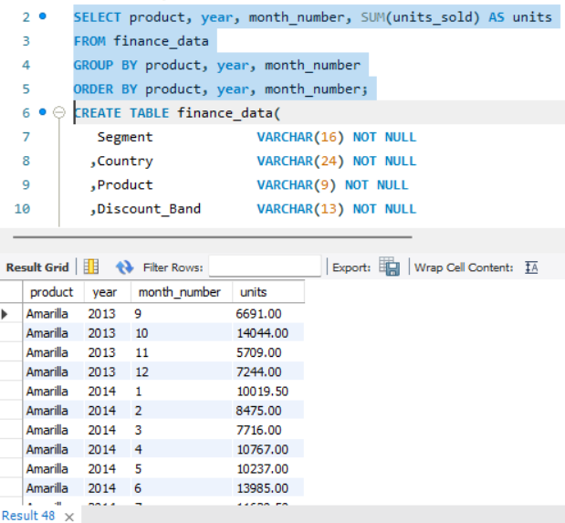
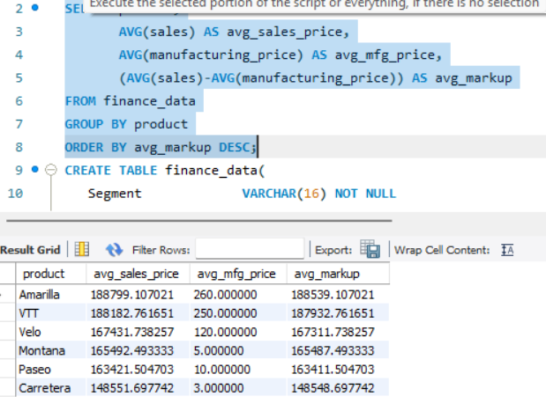
SKU Growth Rate (MoM)
Purpose: Operational planning & inventory.
Price vs Manufacturing Price Gap
Purpose: Markup analysis.
Source : MYSQL

Slide 28
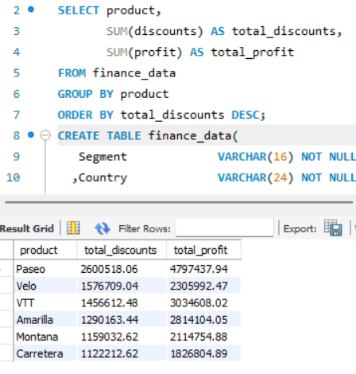
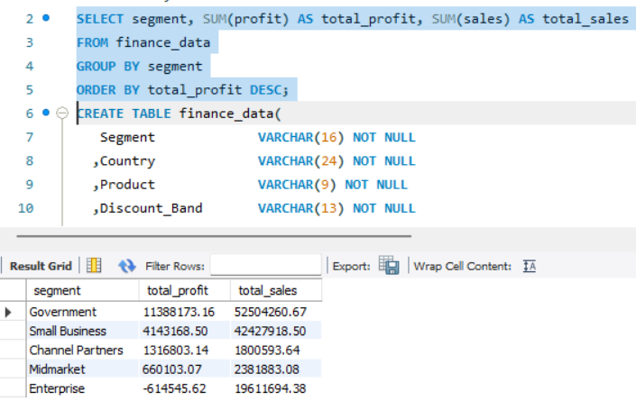
Time to Recover Discount Loss
Purpose: Break-even uplift.
Segment Profitability Proxy
Purpose: Identify profitable segments.
Source : MYSQL

Slide 29
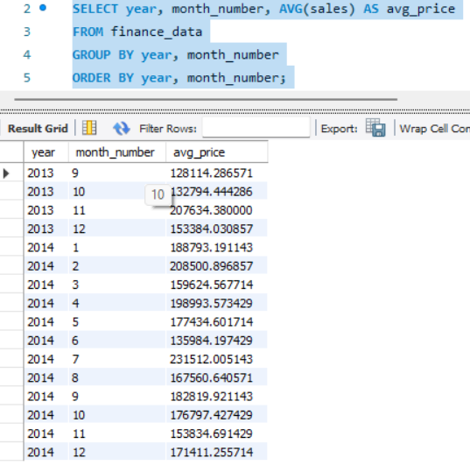
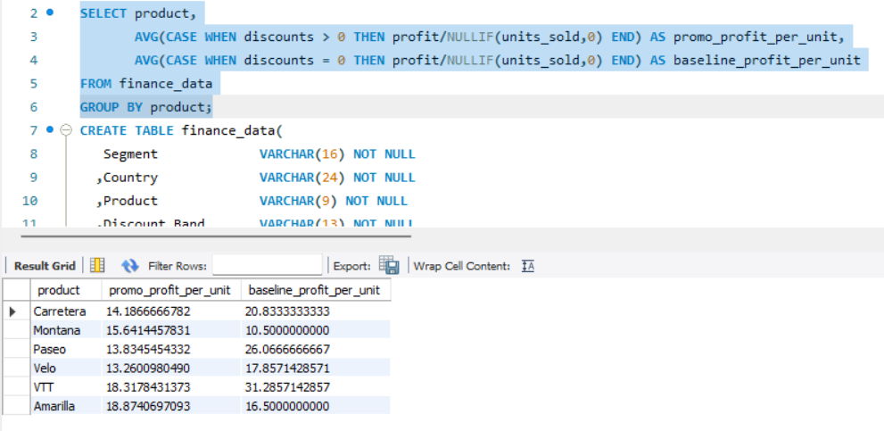
Price Compression Over Time
Purpose: Detect commoditization.
Profitable Promotions
Purpose: Identify margin-positive promos.
Source : MYSQL

Slide 30
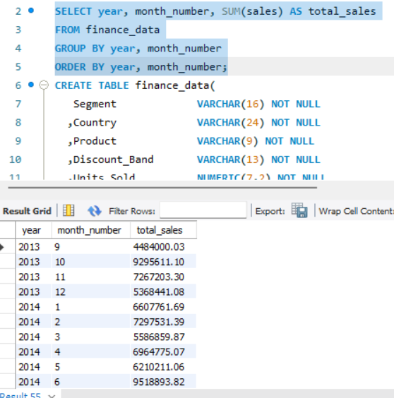
Forecast Baseline
Purpose: Provide inputs to forecasting model.
Source : MYSQL

Slide 31
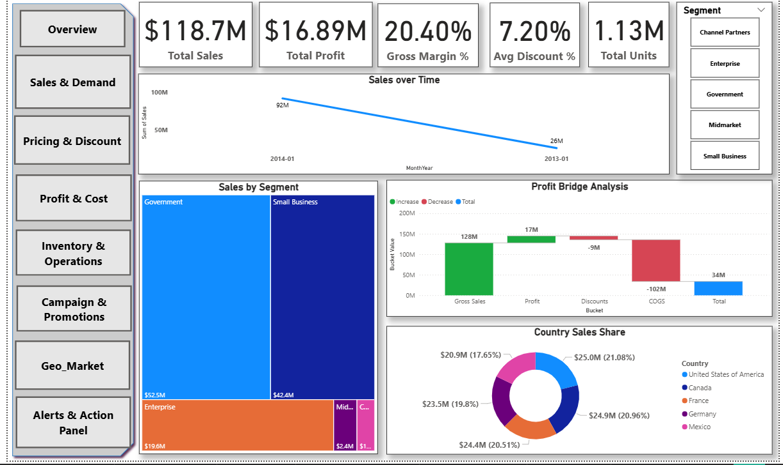
Overview
Source : Power Bi

Slide 32

Sales & Demand
Source : Power Bi

Slide 33

Pricing & Discount
Source : Power Bi

Slide 34

Profit & Cost
Source : Power Bi

Slide 35

Inventory & Operations
Source : Power Bi

Slide 36

Campaign & Promotions
Source : Power Bi

Slide 37

Geo & Market
Source : Power Bi

Slide 38

Source : Power Bi
REFERENCE LINK

Slide 39
Strategic Recommendations
Government contributes the highest revenue and is the most profitable segment. USA, Canada, France are the strongest markets; Mexico underperforms significantly. Sales peak from September–December.
Action :
Double down on government focused Products and Bundles.
Build country-specific pricing (France + Germany have highest profit %, Mexico has worst).
Strengthen marketing and channel partnerships in Canada & France, not just USA.
Fix the Mexico issue:
Localize pricing
Reduce COGS-heavy SKUs
Increase promotions in high-demand seasons (Sep–Dec)
Some high-product (Velo) are not high-profit due to high COGS.
Carretera and Montana are consistent loss makers across all metrics.
Amarilla is high margin but underperforming in volume.
Action :
Immediately review Carretera & Montana → discontinue, reprice, or rebrand.
Improve operational cost on Velo (needs price increase).

Slide 40
Strategic Recommendations
Amarilla & VTT can bear a price increase (high-margin + good demand).
Paseo pricing should remain stable
Reduce COGS via: Manufacturing cost optimization in Velo and VTT.
Medium discount level generates the highest revenue.
Profit ranking by discount band: Low > Medium > High > Zero.
Action :
Replace current discount scheme with tiered incentive-based discounting:
Low discount = high profitability → promote more.
Medium discount = sweet spot → maintain
High discount = rethink & restrict
Zero discount = remove or reposition for premium SKUs only
Offer discount bundles for:
Government segment
midmarket- large volume orders
Renegotiate supplier pricing for Velo & VTT.
Shift production to low-cost regions for Velo.
Review logistics routes in Mexico & Canada.

Slide 41
Strategic Recommendations
Stop discounting for Enterprise segment.
Increase minimum order size for Enterprise.
Reallocate sales efforts to Gov + Small Business.
Profit ranking: Government > Small Business > Channel Partners > Midmarket > Enterprise
Top customers: Mostly Government + Small Business.
Reduce inventory for Velo
Increase working capital allocation for Amarilla and VTT
Build government-focused bundles.

Slide 42
Plato’s Pizza — Sales & Operations Performance Report
Prepared by: Rohit Karmakar
Business Analyst Intern, Unified Mentor

Slide 43
Problem Statement
Maven Pizza have one year of transactional data and want insights to improve sales and operational efficiency.
Manager's questions:
What days & times are we busiest?
How many pizzas are made during peak periods?
Best & worst-selling pizzas?
What’s the average order value?
Seating utilization (15 tables / 60 seats)?
Goal: Convert raw data into a strategic, actionable performance report.

Slide 44


Total Revenue
Average Order Value
Purpose: Measure overall financial performance and the total value generated from all pizza sales.
Purpose: Understand customer spending patterns and identify opportunities to increase per-order revenue.
Source : MYSQL

Slide 45


Total Pizza Sold
Total Orders
Purpose: Track volume performance and assess overall demand for pizzas.
Purpose: Measure transaction activity and understand customer traffic patterns.

Slide 46

Average Pizza Per Order
Purpose: Gauge typical order size and evaluate customer purchasing behavior.

Slide 47

Daily Trend for Total Orders
Purpose: Identify day-to-day demand patterns and detect spikes or slow days.

Slide 48

Monthly Trend for Orders
Purpose: Identify longer-term trends, seasonal patterns, and month-over-month growth.

Slide 49

% Sales by Pizza Category
Purpose: Understand contribution of each pizza category (Classic, Veggie, Supreme, etc.) to total revenue.

Slide 50

% Sales by Pizza Size
Purpose: Analyze customer preferences by size and optimize inventory & pricing.

Slide 51

Total Pizzas Sold by Category
Purpose: Determine category-wise popularity and production demand.

Slide 52


Top 5 Pizzas by Revenue
Bottom 5 Pizzas by Revenue
Purpose: Identify the highest revenue-generating pizzas to prioritize marketing and inventory.
Purpose: Highlight low-performing pizzas for improvement, discounting, or discontinuation.

Slide 53


Top 5 Pizzas by Total Orders
Bottom 5 Pizzas by Total Orders
Purpose: Identify the most frequently ordered pizzas and understand customer preferences.
Purpose: Detect low-demand products to optimize menu offerings.

Slide 54


Top 5 Pizzas by Quantity
Bottom 5 Pizzas by Quantity
Purpose: Determine which pizzas drive the highest unit sales and kitchen throughput.
Purpose: Identify pizzas with low unit movement and potential production inefficiencies.

Slide 55

Seat Utilization %
Purpose: Measure how efficiently seating capacity (15 tables / 60 seats) is used during service hours.

Slide 56

Sales overview
Source : Power Bi

Slide 57

Operational Efficiency
Source : Power Bi

Slide 58

Product Performance
Source : Power Bi
REFERENCE LINK

Slide 59
Strategic Recommendations
1. Customer Economics & Ordering Behavior
Insights
AOV = $38.31 — good, but industry average for casual dining pizza is $42–$47.
Avg Pizza per Order = 2.32 — indicates majority orders are group or family based.
Total Orders = 21,350
50K units sold → strong throughput.
Diagnosis
Customers are:
Buying multiple pizzas per order
Spending decently but below optimal levels
Responding to size-value (L & M dominate)
Strategic Actions
Introduce “Family Bundles”
2-Large + 1 Side + Drink @ $49 → increase AOV by +$6–$8.
Add premium upsell layers
Stuffed crust +$3
Specialty toppings +$2
Side combos +$5
Offer “Add-on at Checkout” upsell
Garlic bread, wings, drinks (convert ~18% customers).

Slide 60
Strategic Recommendations
2. Product & Menu Performance
Strong Performers
Top revenue + orders + units:
Barbecue Chicken, Classic Deluxe, Hawaiian, Pepperoni, Thai Chicken,
These are “Hero SKUs.”
Weak Performers (Bottom 5 SKUs)
Brie Carre, Mediterranean, Spinach Supreme, Calabrese, Spinach Pesto / Soppressata
Diagnosis
We have menu clutter, where weak SKUs are dragging down:
Kitchen throughput
Ingredient cost
Inventory complexity
Operational load
Strategic Actions
Remove or replace 3–5 underperforming SKUs.
Reposition the best sellers with premium versions:
Barbecue Chicken Deluxe
Classic Deluxe Supreme
Expand promotions around Hero SKUs (Profitable AND Popular).

Slide 61
Strategic Recommendations
3. Sales by Pizza Size
Insights
Revenue & orders ranking: L > M > S > XL > XXL XXL barely contributes to revenue.
Diagnosis
Customers prefer value-sized pizzas (L/M). XXL is:
Low demand
High cost
Operationally inefficient
Strategic Actions
Remove XXL or convert to “Party Size Limited Offer.”
Promote L-size combos (highest margin per unit).
Introduce a Premium Medium line with higher toppings value → price elasticity opportunity.
4. Time-of-Day & Day-of-Week Performance
Peak Hours Ranking
12 PM → 1 PM → 6 PM → 5 PM → 7 PM (Mid-day & early evening)
Day Ranking
Fri > Thu > Sat > Wed > Tue > Mon > Sun
Diagnosis
demand is:
Office-driven for lunch (12–1 PM)

Slide 62
Strategic Recommendations
Family-driven for evenings (5–7 PM)
Weekend paradox: strong Friday/Saturday but weak Sunday
This indicates:
Strong downtown/business cluster
Weekend delivery opportunity
Underutilized late evenings (after 8 PM)
Strategic Actions
Lunch Rush Optimization
Pre-made lunch specials
Faster delivery radius
Prep batching between 11 AM–12 PM
Evening Demand Boosters
“Family Dinner Box” (5–7 PM)
Loyalty points for Fri–Sat orders
Fix Sunday
Launch “Sunday Family Feast” @ $34
Promote kids menu, side combos
Late-night activation (8–11 PM)
Offer $2 off pickup-only
Partner with food delivery apps reduced fee window

Slide 63
Strategic Recommendations
5. Monthly Revenue Cycle
Months ordered: July > May > March > Nov > Jan > April > August > June > Feb > Dec > Sept > Oct
Diagnosis
Peak demand in summer months (March–July)
Secondary demand in holiday months (Nov–Jan)
Lowest demand around Sept–Oct (post-summer slump)
Strategic Actions
Introduce Summer BBQ Pizza Campaign (high-margin barbecue SKUs).
Push Holiday Party Orders heavily in Nov–Dec.
Run “Back-to-Work” promotions in Sept–Oct to recover slump.
6. Operational Efficiency
Strategic Actions
Improve restaurant ambiance (lighting, seating ergonomics).
Introduce dine-in exclusive menu items (e.g., Garlic Wings, Cheese Bombs).
Run dine-in–only discounts during off-peak hours.
Promote corporate lunches (12–2 PM).
Increase table turnover with pre-batched topping prep.

Slide 64
Supply Chain Management – Full Analysis
Prepared by: Rohit Karmakar
Business Analyst Intern, Unified Mentor

Slide 65
Project Overview
Objective: Build a comprehensive Supply Chain Management dashboard using company data.
Focus Areas:
Inventory levels
Supplier performance
Order fulfillment
Transportation efficiency
Supply chain cost analysis
Outcome: Enable data-driven decision-making across the supply chain.

Slide 66
Problem Statement
Supply chain analytics optimizes the movement of goods from suppliers to customers.
The dataset includes product type, pricing, stock levels, lead times, manufacturing data, defect rates, logistics routes, shipping metrics, and customer segments.
Goal: Analyze inventory, supplier, logistics, and revenue performance to improve operations.

Slide 67


Total Stock
Avg Stock Level
Purpose: Measure total inventory.
Purpose: Evaluate typical stock holding.
Source : MYSQL

Slide 68

Inventory Turnover
Purpose: Assess speed of inventory movement.
Source : MYSQL

Slide 69

Days of Inventory on Hand
Purpose: Estimate inventory longevity.
Source : MYSQL

Slide 70


Slow-Moving Inventory
Fast-Moving Inventory
Purpose: Identify low-demand high-stock items.
Purpose: Highlight high-demand SKUs.
Source : MYSQL

Slide 71


Excess Inventory Value
Reorder Point
Purpose: Measure cost of overstock.
Purpose: Determine optimal reorder timing.
Source : MYSQL

Slide 72


Stock-out Items
Fill Rate %
Purpose: Identify items unavailable during demand.
Purpose: Measure order fulfillment efficiency.
Source : MYSQL

Slide 73


Backorder Volume
Inventory by Product Type
Purpose: Track delayed orders.
Purpose: Analyze category-level stock.
Source : MYSQL

Slide 74


Stock Aging
Max Lead Time
Purpose: Assess inventory aging using lead time.
Purpose: Identify slowest supplier.
Source : MYSQL

Slide 75


Avg Lead Time
Supplier On-Time Delivery
Purpose: Measure average supplier speed.
Purpose: Evaluate supplier reliability.
Source : MYSQL

Slide 76


Supplier Defect Rate
Supplier Performance Score
Purpose: Measure supplier quality issues.
Purpose: Benchmark supplier performance.
Source : MYSQL

Slide 77


Cheapest Supplier
Most Reliable Supplier
Purpose: Find lowest manufacturing cost source.
Purpose: Identify best-performing supplier.
Source : MYSQL

Slide 78


Total Spend Per Supplier
Supplier Region-wise Analysis
Purpose: Track procurement spend distribution.
Purpose: Analyze supplier geography performance.
Source : MYSQL

Slide 79


Lead Time Variance
Highest Defect Supplier
Purpose: Measure supplier delivery stability.
Purpose: Identify worst quality supplier.
Source : MYSQL

Slide 80


Avg Shipping Time by Carrier
Total Shipping Cost by Carrier
Purpose: Measure carrier speed.
Purpose: Track logistics costs.
Source : MYSQL

Slide 81


Cost per Unit per Carrier
Carrier Speed Ranking
Purpose: Evaluate shipping cost efficiency.
Purpose: Rank carriers by delivery speed.
Source : MYSQL

Slide 82


Slowest Carrier
Cheapest Carrier
Purpose: Identify slowest shipping partner.
Purpose: Find lowest cost carrier.
Source : MYSQL

Slide 83


Route Cost Analysis
Top Routes by Volume
Purpose: Evaluate route cost efficiency.
Purpose: Identify most used routes.
Source : MYSQL

Slide 84

Avg Transportation Cost by Mode
Purpose: Compare transport modes.
Source : MYSQL

Slide 85

Max Shipping Time
Purpose: Detect extreme delays.
Source : MYSQL

Slide 86


Logistics Cost Breakdown
Orders per Carrier
Purpose: Analyze logistics cost structure.
Purpose: Analyze workload distribution.
Source : MYSQL

Slide 87

Defective Units
Purpose: Measure defective product count.
Source : MYSQL

Slide 88

Yield Rate
Purpose: Measure production quality success rate.
Source : MYSQL

Slide 89


Avg Defect Rate
Inspection Pass Rate
Purpose: Track average defect levels.
Purpose: Evaluate inspection success.
Source : MYSQL

Slide 90


Failed Inspection Count
Defect Rate by Product
Purpose: Measure failed quality checks.
Purpose: Identify high-defect SKUs.
Source : MYSQL

Slide 91


Total Revenue
Revenue by Product Type
Purpose: Measure total revenue.
Purpose: Analyze revenue by category.
Source : MYSQL

Slide 92


Best-Selling Products
Worst-Selling Products
Purpose: Identify top-selling items.
Purpose: Highlight lowest sellers.
Source : MYSQL

Slide 93


Profit per SKU
SKU with Highest Revenue
Purpose: Evaluate SKU-level profitability.
Purpose: Identify top revenue SKU.
Source : MYSQL

Slide 94


Revenue per Customer Segment
Revenue per Supplier
Purpose: Compare revenue across customer groups.
Purpose: Track supplier revenue contributions.
Source : MYSQL

Slide 95


Revenue per Route
Cost-to-Revenue Ratio
Purpose: Evaluate profit per logistics route.
Purpose: Measure operational efficiency.
Source : MYSQL

Slide 96


Average Order Quantity
Avg Price per Unit
Purpose: Measure average customer order size.
Source : MYSQL

Slide 97

Overview
Source : Power Bi

Slide 98

Inventory
Source : Power Bi

Slide 99

Suppliers & Procurement
Source : Power Bi

Slide 100

Manufacturing & Production
Source : Power Bi

Slide 101

Logistics & Transportation
Source : Power Bi

Slide 102

Cost, Profitability & Financials
Source : Power Bi
REFERENCE LINK

Slide 103
Strategic Recommendations
INVENTORY MANAGEMENT
Key Insights
Total stock = 4,777 and avg stock = 47.77, indicating moderate inventory depth.
Inventory turnover = 965× → extremely efficient selling, almost too lean.
Days of inventory = 0.38 → dangerously close to daily stockout risk.
Fill rate = 10.68% → critical supply failure.
Backorders = 1,483 → severe service-level gap.
SKU68 unavailable during demand.
High-demand SKUs (SKU10, SKU49, SKU94, SKU9, SKU36)
→ must be prioritized in procurement & forecasting.
Excess Inventory SKUs (SKU49, SKU55, SKU89)
→ capital trapped in slow-moving SKUs.
Stock Aging (SKU69, SKU48, SKU90 )
→ indicates poor forecasting & overstocks.
Strategic Actions
A. Fix Fill Rate (Top Priority)
Increase safety stock for top 15 SKUs immediately.
Approve expedited orders for SKU68, SKU69, SKU48.
B. Reorder Points
customize by sales velocity.

Slide 104
Strategic Recommendations
B. Reduce Excess Stock
Discount SKU49, SKU55 urgently.
Bundle slow SKUs with fast-movers.
C. Implement ABC Inventory Control
A: SKU10, SKU94, SKU9, SKU36 (80% revenue)
B: Mid-tier SKUs
C: SKU2, SKU45, SKU85 (phase out)
2. SUPPLIER PERFORMANCE
Key Insights
Best On-time Delivery: Supplier 3
Best Quality: Supplier 1
Worst Quality: Supplier 5
Lowest Cost Supplier: Supplier 4
Supplier Stability Issues: Sup3 (-6), Sup2 (-3) inconsistent
Manufacturing cost by city: Best = Bangalore → Worst = Delhi
Strategic Actions
A. Reallocate Spend
Shift volume to Supplier 1 & 3 (best performance profile).
Reduce dependency on Supplier 5 immediately.

Slide 105
Strategic Recommendations
B. Supplier Contracting
Penalty clause for delays (Sup2/3).
Reward system for on-time (Sup1, Sup3).
C. Manufacturing Footprint Strategy
Move production to Bangalore, Kolkata.
Reduce manufacturing in Delhi & Mumbai.
3. LOGISTICS & TRANSPORTATION
Key Insights
Fastest carrier: B
Cheapest carrier: C
Most expensive: B
Slowest: A
Highest cost route: Route B
Highest volume route: Route A
Avg transport cost by mode: Air > Road > Rail > Sea
Strategic Actions
A. Optimize Carrier Assignment
Use Carrier B for urgent shipments only.
Shift bulk movement to Carrier C.
Reduce Carrier A usage drastically.

Slide 106
Strategic Recommendations
B. Route Optimization
Reprice or renegotiate Route B.
Shift load to Route A wherever possible.
C. Mode Shift Strategy
Move high-cost air shipments to road or rail.
4. QUALITY & INSPECTION
Key Insights
Defective units = 133,829 → extremely high waste.
Yield rate = 97.64% good but overshadowed by volume defects.
Inspection pass = 23, Failed = 36 → weak QC process.
Haircare has highest defect rate.
Strategic Actions
A. Strengthen QC at Source
Suppliers with highest defects (Sup5, Sup2) must undergo corrective action plans.
B. Implement Fault Analysis
Trace defects by SKU & supplier combination to root the worst offenders.
C. Move Defect-Prone Production
Haircare SKUs should be manufactured only at high-yield locations.

Slide 107
Strategic Recommendations
5. REVENUE & PROFITABILITY
Key Insights
Total revenue = $577.6K
Total cost = $58K
Gross margin = 89.92% (strong).
Profit = $519.4K
ROI on Inventory = 244× (excellent).
Top revenue SKUs: SKU51
Best-selling SKUs: SKU10, SKU94, SKU9, SKU37, SKU36, SKU11
Worst-selling: SKU2, SKU45, SKU85, SKU48, SKU70, SKU97
Strategic Actions
A. Double Down on Hero SKUs
Increase safety stock for SKU10, SKU94, SKU9, SKU37.
B. Rationalize Worst Performers
Phase-out SKU2 (low demand + low revenue + defects).
Replace SKU45, SKU85 with variants or merge SKUs.
C. Segment Revenue
Female & Unknown segments dominate → Target them.
Launch campaigns for male & non-binary to balance revenue.

Slide 108
Stock Market Performance Analysis
Prepared by: Rohit Karmakar
Business Analyst Intern, Unified Mentor

Slide 109
Project Overview
Dataset: 3 months of stock market data for Apple, Microsoft, Netflix, and Google.
Objective: Identify trends, volatility, and performance differences.
Techniques Used:
• Moving averages
• Volatility analysis
• Correlation analysis
• Trend detection
Goal: Build actionable market insights for data-driven decision-making.

Slide 110
Problem Statement
Analyze and compare stock performance of AAPL, MSFT, NFLX, and GOOG using:
• Trend and price pattern analysis
• Volatility measurement
• Moving averages
• Correlation analysis
Purpose: Identify market opportunities, stock stability, and return patterns.

Slide 111


Total Market Size by Month (Volume)
Total Market Size by Month (Traded Value)
Purpose: Measure overall market participation.
Purpose: Evaluate monetary value traded.
Source : MYSQL

Slide 112

Market Share by Company (Volume)
Purpose: Gauge investor focus by trading activity.
Source : MYSQL

Slide 113

Market Share by Traded Value
Purpose: Analyze value contribution per stock.
Source : MYSQL

Slide 114

Month-over-Month Growth % in Total Volume
Purpose: Identify shifts in trading participation.
Source : MYSQL

Slide 115

Month-over-Month Growth % in Traded Value
Purpose: Measure changes in traded value.
Source : MYSQL

Slide 116


Average Price per Ticker
Daily Return per Ticker
Purpose: Identify typical price levels.
Purpose: Measure daily performance shifts.
Source : MYSQL

Slide 117

Volatility (Standard Deviation of Daily Returns)
Purpose: Assess stock price stability.
Source : MYSQL

Slide 118

Top Gaining Stocks (%)
Purpose: Identify best-performing stocks.
Source : MYSQL

Slide 119


Investor Interest Trend (by volume)
High Trading Activity Days
Purpose: Reveal long-term participation changes.
Purpose: Detect unusual trading spikes.
Source : MYSQL

Slide 120


Days Price Increased
Days Price Decreased
Purpose: Measure positive sentiment.
Purpose: Identify bearish pressure.
Source : MYSQL

Slide 121


High-Low % Movement
Days >5% Spike
Purpose: Track intraday volatility.
Purpose: Detect extreme price movement.
Source : MYSQL

Slide 122


Bullish Days (>20-day MA)
Lowest Closing Price
Purpose: Identify upward momentum.
Purpose: Identify market lows.
Source : MYSQL

Slide 123

Identify bearish days (Close < 20-day average Close)
Purpose: Identify downward trends.
Source : MYSQL

Slide 124


7-day Moving Average
Top 10 High-Volume Days
Purpose: Smooth short-term movement.
Purpose: Identify busiest market sessions.
Source : MYSQL

Slide 125


Lowest Liquidity Days
Daily Return
Purpose: Identify weak trading activity.
Purpose: Measure day-to-day price changes.
Source : MYSQL

Slide 126


Average Daily Return
Max 1-Day Gain
Purpose: Evaluate expected return.
Purpose: Highlight strongest gain day.
Source : MYSQL

Slide 127


Max 1-Day Loss
Return Variance
Purpose: Reveal worst loss day.
Purpose: Assess performance stability.
Source : MYSQL

Slide 128


True Range (high–low)
ATR (Average True Range), 14-day
Purpose: Measure intraday movement.
Purpose: Track volatility trends.
Source : MYSQL

Slide 129


Breakout Days (>30-day High)
Rank Stocks by Avg Return
Purpose: Detect bullish breakouts.
Purpose: Compare overall performance.
Source : MYSQL

Slide 130


Top Performing Stocks
Most Stable Stocks
Purpose: Identify highest-returning stocks.
Purpose: Highlight low-volatility stocks.
Source : MYSQL

Slide 131

Price Ratio (Close/Open)
Purpose: Analyze intraday momentum.
Source : MYSQL

Slide 132

Market Overview
Source : Power Bi

Slide 133

Performance & Momentum
Source : Power Bi

Slide 134

Volatility & Risk
Source : Power Bi

Slide 135

Volume & Liquidity
Source : Power Bi

Slide 136

Technical Signals & Trade Ops
Source : Power Bi
REFERENCE LINK

Slide 137
Strategic Recommendations
MARKET SIZE & GROWTH
Insights
Market size highest in March > April > Feb > May (both volume & traded value).
MoM volume:
Feb → Mar: +50.63%
Mar → Apr: -33%
Apr → May: -71%
MoM traded value:
Feb → Mar: +57.29%
Mar → Apr: -26%
Apr → May: -71.84%
Diagnosis
March represents a tech rally, possibly earnings-driven.
The steep decline after April suggests:
Market uncertainty
Liquidity tightening
Investors shifting to defensive positions
Strategic Actions
Buy in May / June — discount window when activity is lowest.
Increase weight in high-volume months (March) for short-term trades.
Build a market seasonality model to anticipate volume-driven spikes.

Slide 138
Strategic Recommendations
2. COMPANY PERFORMANCE
Market Share
AAPL > MSFT > GOOG > NFLX (both volume & value) → AAPL is the liquidity leader.
Price Growth Performance
MSFT: +26.14% (Best)
NFLX: +25.30%
AAPL: +19.45%
GOOG: -2.90% (Only negative)
Average Price
Highest: NFLX ($327)
Lowest: GOOG ($100) → cheap valuation.
Strategic Actions
A. Portfolio Allocation Strategy
Overweight MSFT & NFLX (high momentum, strong growth).
Hold AAPL (stable long-term compounding).
Accumulate GOOG (undervalued, low volatility, high stability).
B. For Trading Strategy
Play breakout opportunities on strong trending stocks (AAPL, MSFT).
Use dip-buying strategy on GOOG due to strong stability indicators.

Slide 139
Strategic Recommendations
3. VOLATILITY & RISK
Volatility Ranking
Lowest risk → AAPL (0.011)
Highest risk → NFLX (0.018)
Stability Score (lower = better)
GOOG (6.23)
AAPL (7.30)
MSFT (17.53)
NFLX (18.40)
Extreme Price Spike
NFLX on 2023-03-23 → likely earnings-related.
Strategic Actions
GOOG + AAPL = Defensive Portfolio Core
MSFT = Balanced Growth Asset
NFLX = High-Volatility, High-Reward play
Implement stop-loss strategies for NFLX & MSFT during volatile months.
Build event-based trading rules around earnings & macro announcements.

Slide 140
Strategic Recommendations
4. PRICE TREND & DAILY BEHAVIOR
Price Movement Days
AAPL increases 41 days / falls 21 days
GOOG increases 33 / falls 29
MSFT & NFLX increase only 26 days → more volatile.
Avg Daily Return
AAPL: 0.29%
GOOG: 0.26%
MSFT: 0.11%
NFLX: -0.13%
Max 1-Day Gain
Best spike: NFLX (+5.14%)
Max 1-Day Loss
Worst crash: GOOG (-5.02%)
Strategic Actions
AAPL = best compounding return with lowest downside risk.
NFLX = momentum-driven swing trading asset.
MSFT = long-term buy, short-term low return.
GOOG = defensive value play.

Slide 141
Strategic Recommendations
5. BREAKOUT & TECHNICAL INDICATORS
Breakout Day
GOOG triggered breakout on 2023-02-09, but failed to hold above previous 30-day high.
Price Ratio (Close / Open)
AAPL: 1.003
GOOG: 1.003
MSFT: 1.001
NFLX: 0.998 (underperforms intraday)
Strategic Actions
Use breakout strategy for AAPL & GOOG during liquidity spikes.
Avoid intraday trades on NFLX (tends to close lower than open).
6. MARKET-WIDE INSIGHTS
Totals
Total traded value: $1.44 Trillion
Total market volume: 8 Billion shares
Avg closing price across market: $215.38
Actions
Market is high liquidity and tech-driven → ideal for algorithmic & institutional strategies.
Build market-wide volume momentum model around March and April.

Slide 142
Thank You

